Slide 1

PATBMS Patient Admission, Triage and Bed Management System
Waitakere Hospital – Te Whatu Ora Health New Zealand
Mohammed Yaacoub Abou Chlih
21138726
ENSE706 || 19/04/2026

Slide 2
Organisation Overview Waitakere Hospital
Public hospital under Te Whatu Ora Health New Zealand Waitemata
Servers roughly 650,000 residents across North Shore, Waitakere, and Rodney
Renovated in 2005 with expanded facilities
Key Departments:
Emergency Care Centre (ECC)
Assessment and Diagnostic Unit (ADU)
Surgical Unit
Mental Health Unit
Allied Health Team
Medical Wards

Slide 3
System and Requirements PATBMS – Why it exists
Coordinates patient flow across departments
Manages bed availability in real time
Supports triage, admission, handover, discharge and registration
Key Requirements:
FR8 – Triage with ATS categories (1-5)
FR9 – Bed allocation with approval workflow
FR10 – Inter-department handover
FR11 – Discharge with real-time bed updates
FR13 – Role based login
5 User Roles: Doctors, Nurses, Allied Health, Admin Staff, Management

Slide 4
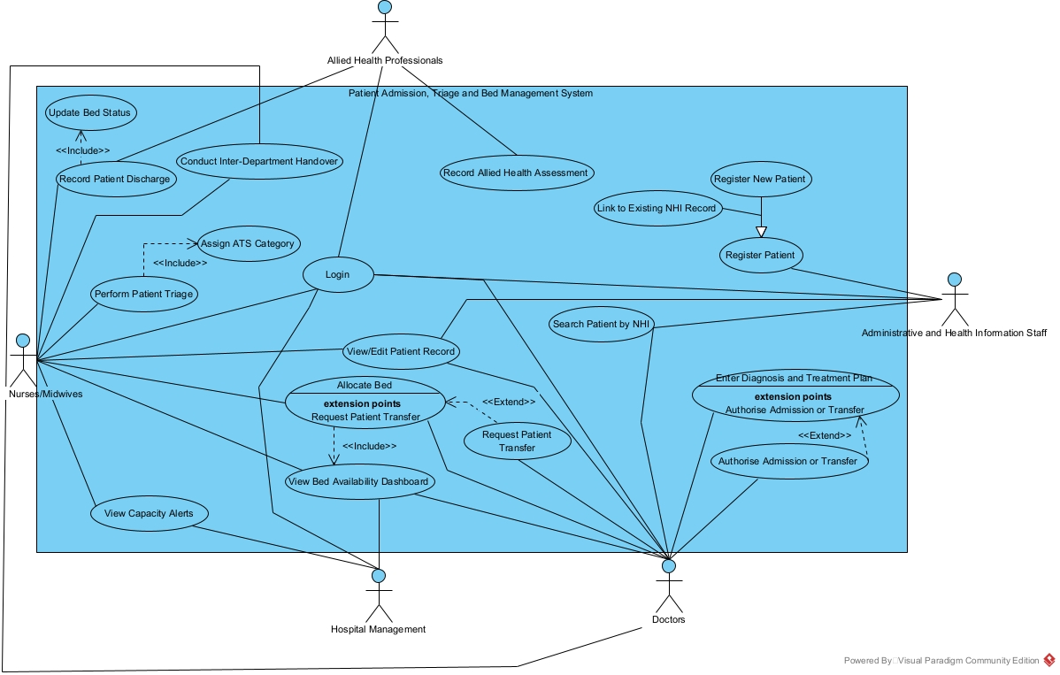
Use Case Diagram
Key Relationships:
Include – Allocate bed includes View Bed Dashboard
Extend – Request Transfer extends Allocate bed
Generalisation – Register New Patient and Link NHI -> Register Patient

Slide 5
Use Case Descriptions Five Fully Dressed Use Cases
UC1 – Perform Patient Triage
UC2 – Allocate Bed
UC3 – Register Patient
UC4 – Conduct Inter-Department Handover
UC5 – Enter Diagnosis and Treatment Plan
Each use case defines: Pre-conditions, Event Flow, Post-conditions, Extension Points

Slide 6
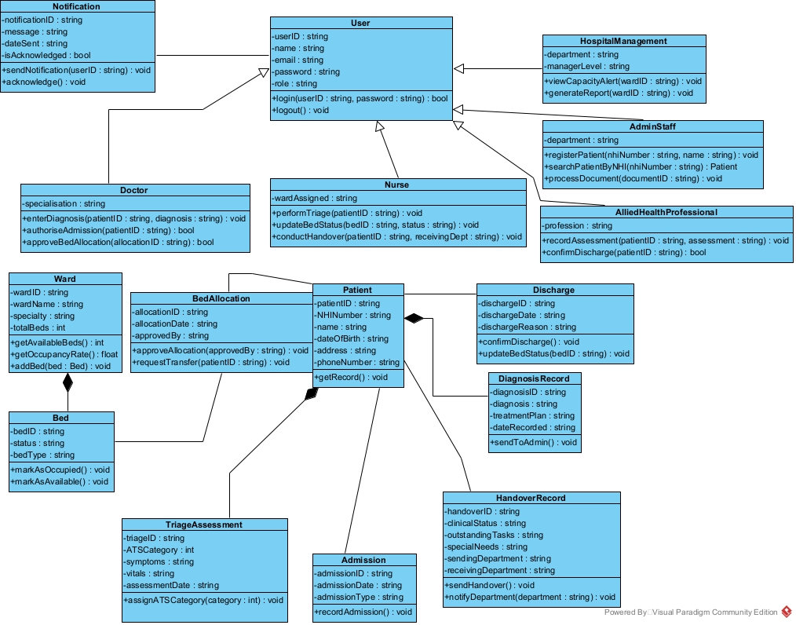
Class Diagram
Key Design Decisions:
User hierarchy – Doctor, Nurse, Allied Health, Admin, Management inherit from User
Composition – Ward owns bed, Patient owns TriageAssessment and DiagnosisRecord
Association – BedAllocation, Discharge, Handover, and admission all reference Patient independently
16 domain classes in total

Slide 7
C# Implementation OOP Implementation – Key Highlights
16 classes consistent with UML diagram
Inheritance – all staff classes extend User base class
Encapsulation – private fields with public properties
Business Rules – ATS category validated between 1 and 5
Demo flow:
Login
Register Patient
Perform Triage
Allocate Bed
Record Discharge
Send Notification
Conduct Handover
Allied Health and Management

Slide 8
Design Weaknesses and Part 2
No interfaces – behaviour isn’t properly abstracted
Role stored as string – no validation enforcement
Separation of responsibilities – Discharge.UpdateBedStatus() should belong to Bed
No access control mechanism in class structure
Part 2 improvements:
Implement interfaces for notification and reports
Replace role string with enum
Enforce role-based access control
Full NHI database integration per NFR7
GUI

